Slide 1
CS 474: Computer Vision
Lecture 7: Camera Model
Asif Rajput

Slide 2
Today
Hough Transform
Geometric Camera Models
Pinhole cameras
Cameras & Lenses
The geometry of pinhole cameras
Projection matrix
Intrinsic parameters
Extrinsic parameters

Slide 3
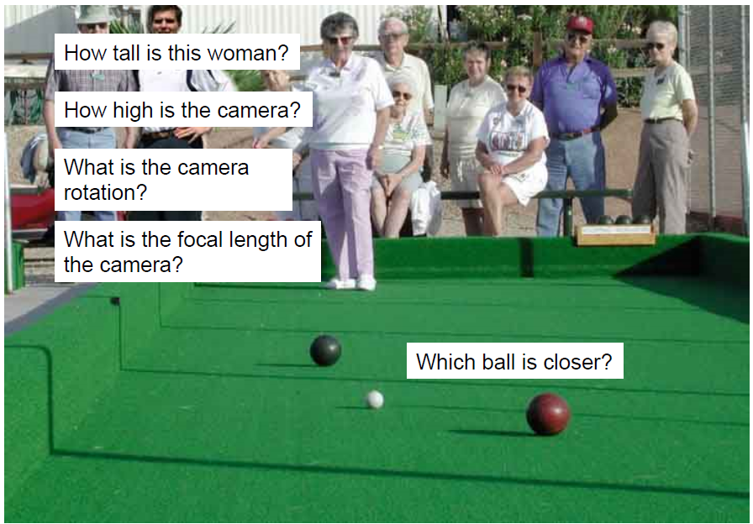
Camera and World Geometry

Slide 4
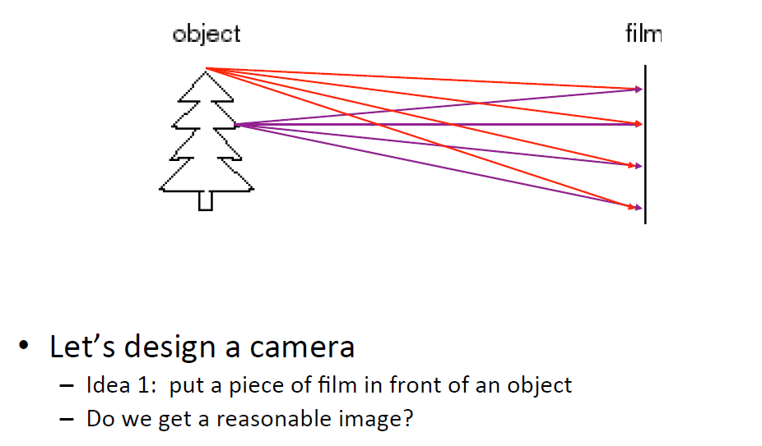
How do we see the World?

Slide 5
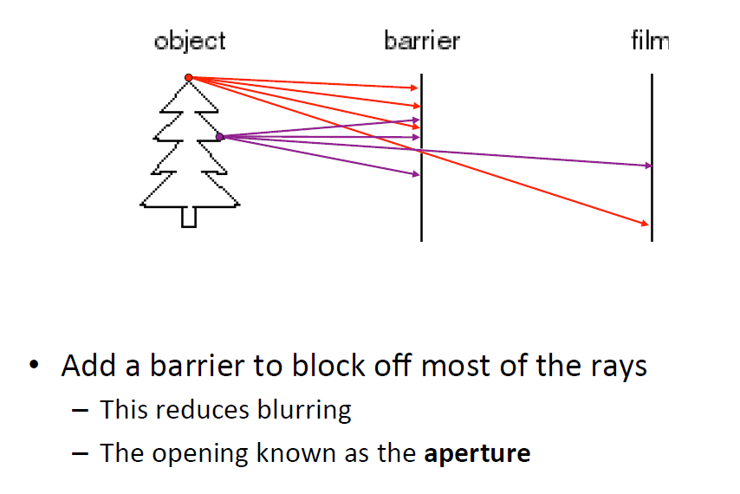
Pinhole Camera

Slide 6
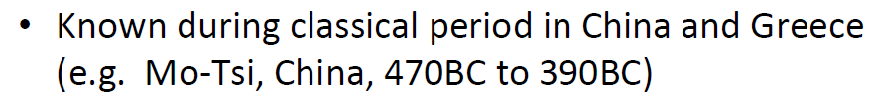
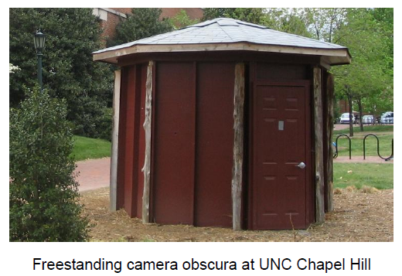
Camera obscura: the pre-camera

Slide 7
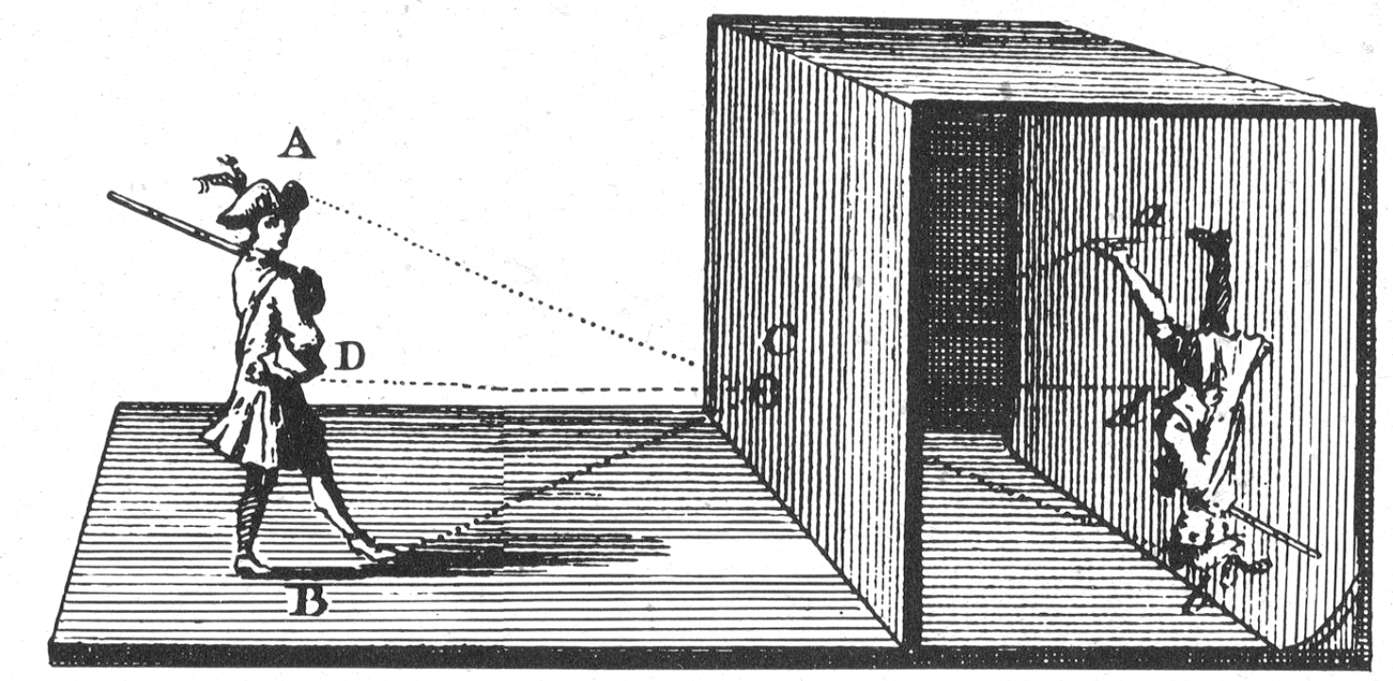
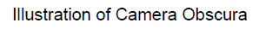
Camera obscura: the pre-camera
Camera obscura meaning "dark room" in Latin, also referred to as pinhole image is the natural optical phenomenon that occurs when an image of a scene at the other side of a screen (or for instance a wall) is projected through a small hole in that screen as a reversed and inverted image on a surface opposite to the opening.

Slide 8
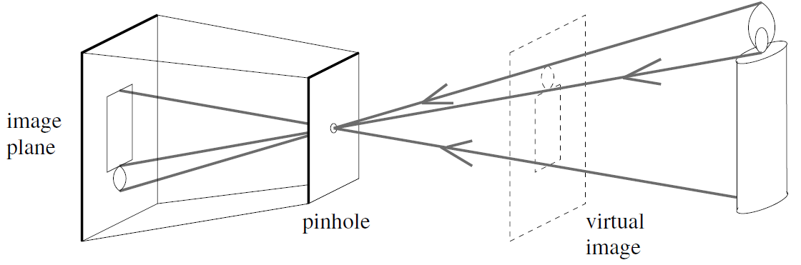
Pinhole Camera Model

Slide 9
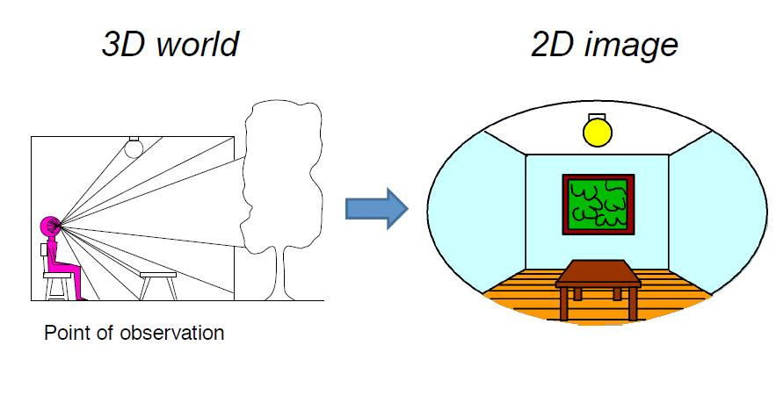
Dimensionality Reduction Machine (3D to 2D)

Slide 10

Projection can be tricky ...

Slide 11
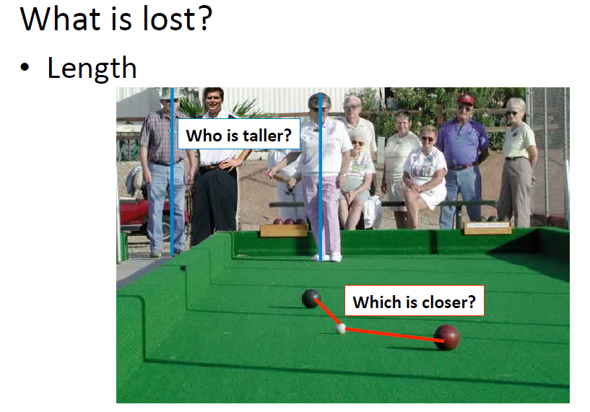
Projective Geometry

Slide 12
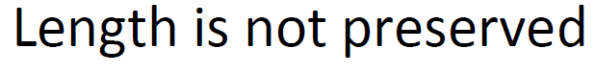
Projective Geometry

Slide 13
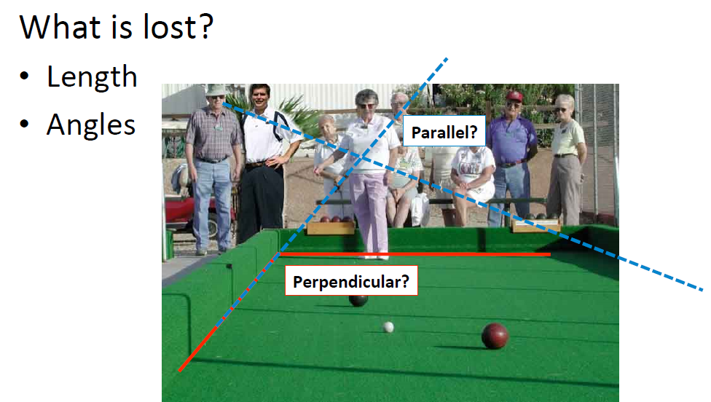
Projective Geometry

Slide 14
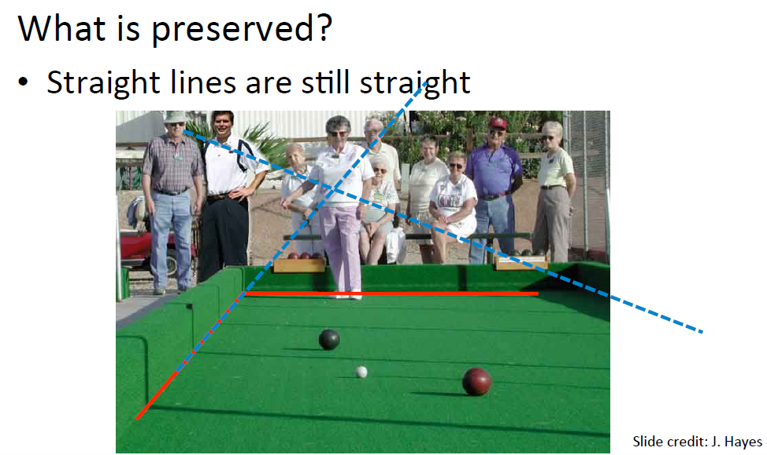
Projective Geometry

Slide 15
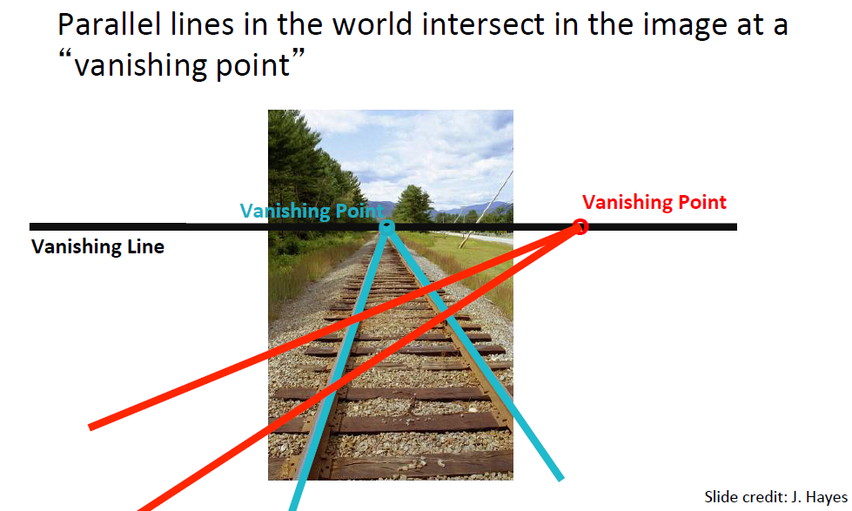
Vanishing points and lines

Slide 16
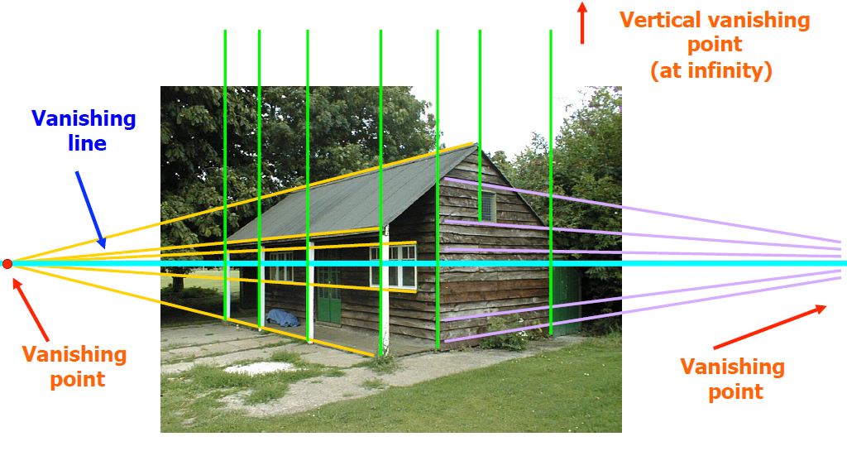
Vanishing points and lines

Slide 17
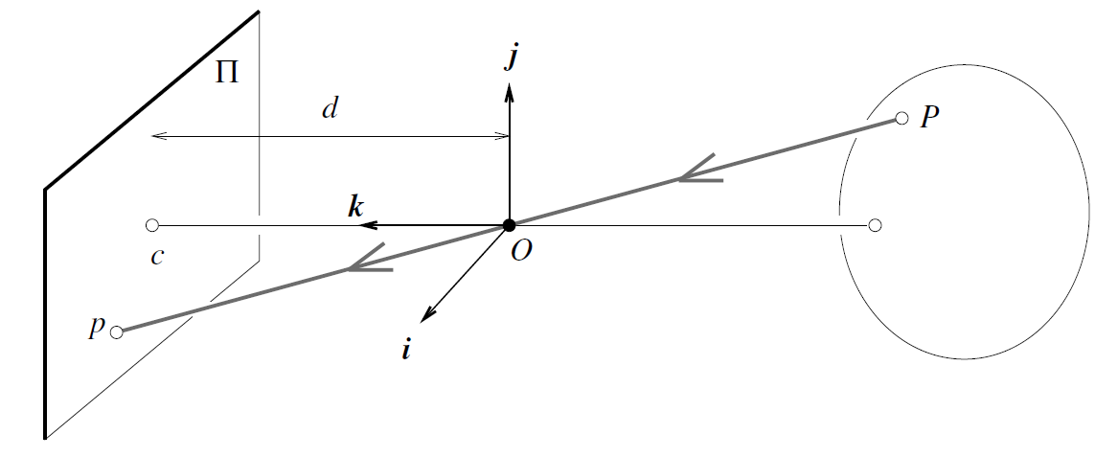
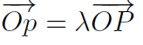
Pinhole Camera Perspective
Since the three points P, O, and p are collinear, we have

Slide 18
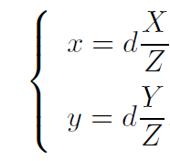
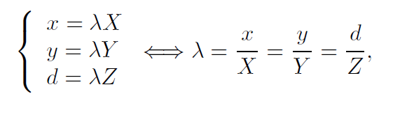
Pinhole Camera Perspective

Slide 19
Pinhole Camera Perspective
• Common to draw image plane infront of the focal point
• Moving the image plane merely scales the image.

Slide 20
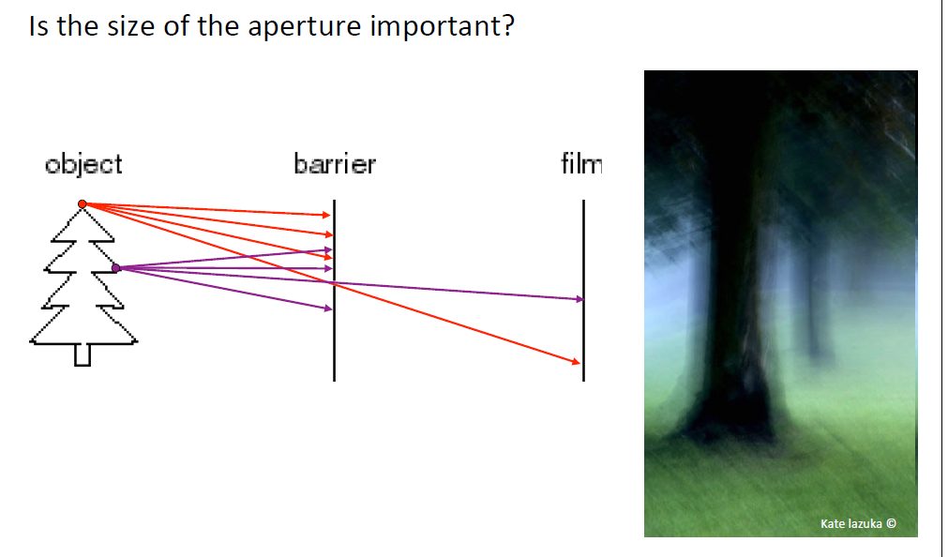
Pinhole Camera Perspective

Slide 21
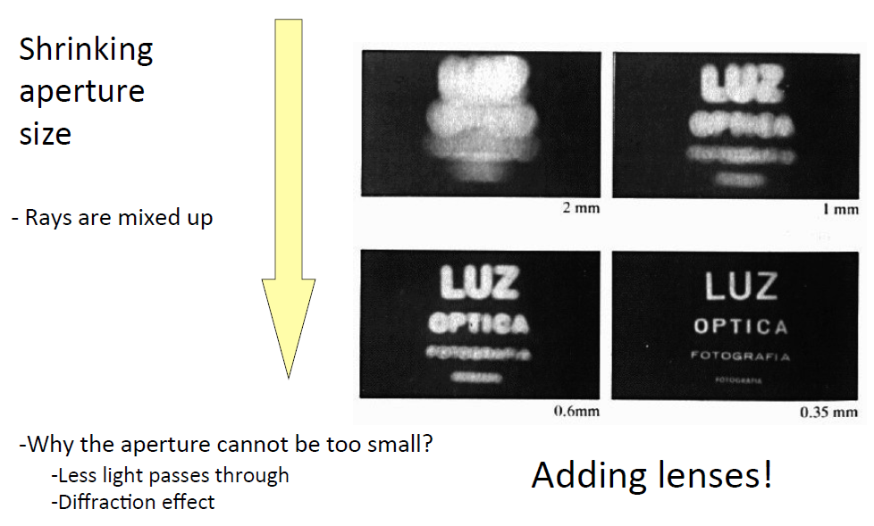
Cameras & Lenses

Slide 22
Today
Hough Transform
Geometric Camera Models
Pinhole cameras
Cameras & Lenses
The geometry of pinhole cameras
Projection matrix
Intrinsic parameters
Extrinsic parameters

Slide 23
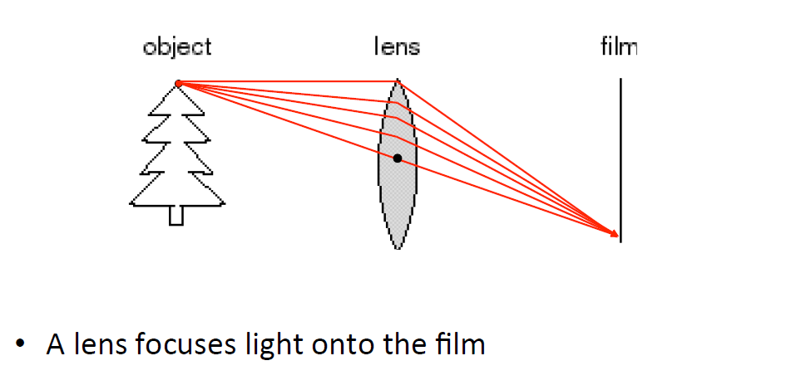
Cameras & Lenses

Slide 24
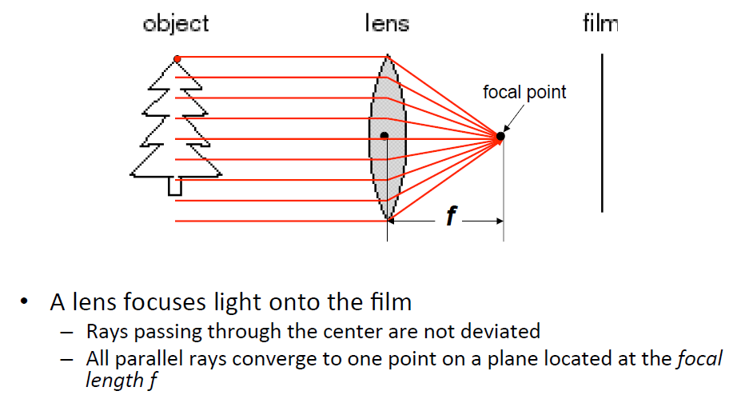
Cameras & Lenses

Slide 25
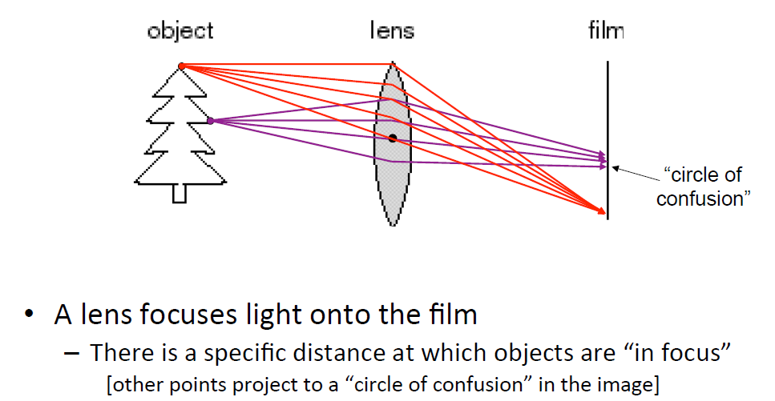
Cameras & Lenses

Slide 26
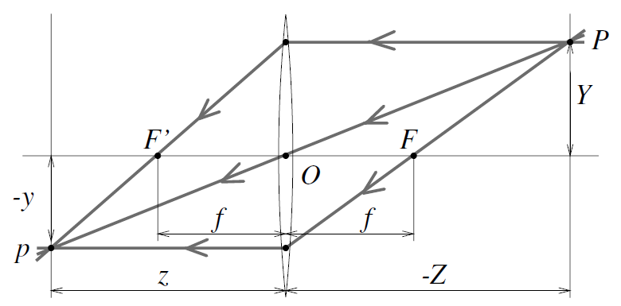
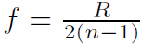
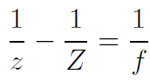
Cameras & Lenses
Note that the equations relating the positions of P and p are exactly the same as under pinhole perspective projection if we take d = z since P and p lie on a ray passing through the center of the lens
However the points located at a distance −Z from O will be in sharp focus only when the image plane is located at a distance z from O on the other side of the lens that satisfies the thin lens equation:
where f is the focal length of the lens
R is radius of spherical surfaces of the lens
n is the index of refraction of the lens

Slide 27
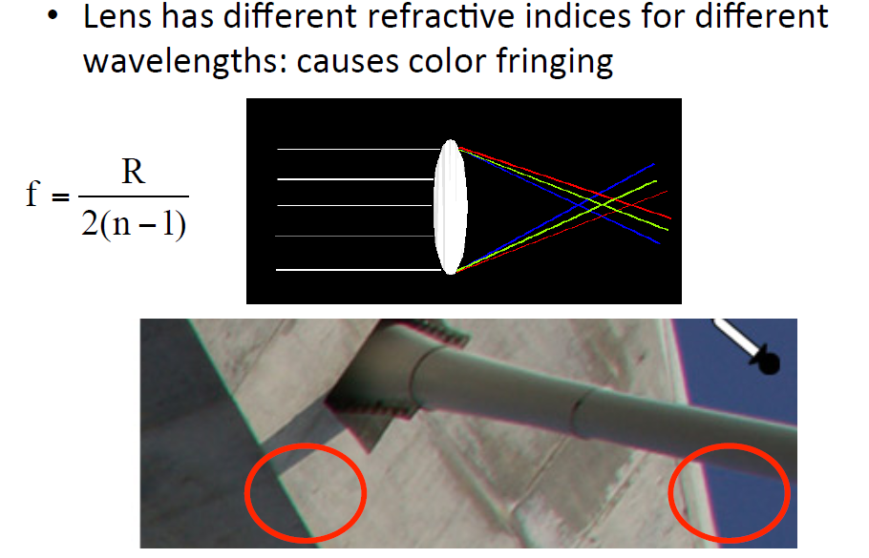
Issues with lenses: Chromatic Aberration
The index of refraction of a transparent medium depends on wavelength, and it follows from the thin lens equation that the focal length depends on wavelength as well. This causes the phenomenon of chromatic aberration:
I.e., the refracted rays corresponding to different wavelengths will intersect the optical axis at different points and form different circles of confusion in the same image plane

Slide 28
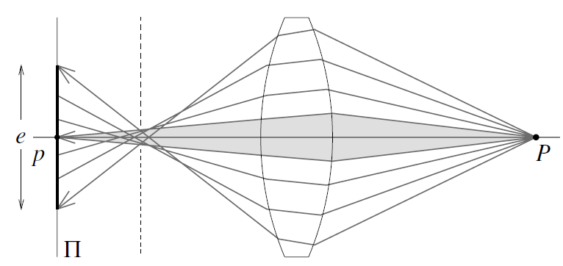
Issues with lenses: Spherical aberration
Rays farther from the optical axis focus closer

Slide 29
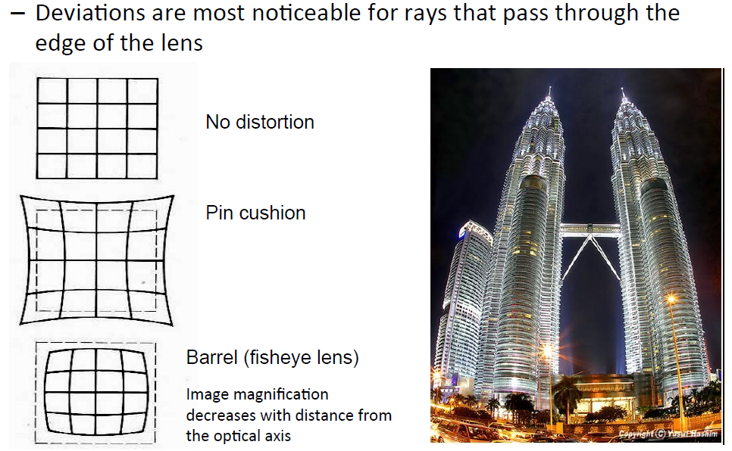
Issues with lenses: Radial Distortion

Slide 30
Today
Hough Transform
Geometric Camera Models
Pinhole cameras
Cameras & Lenses
The geometry of pinhole cameras
Projection matrix
Intrinsic parameters
Extrinsic parameters

Slide 31
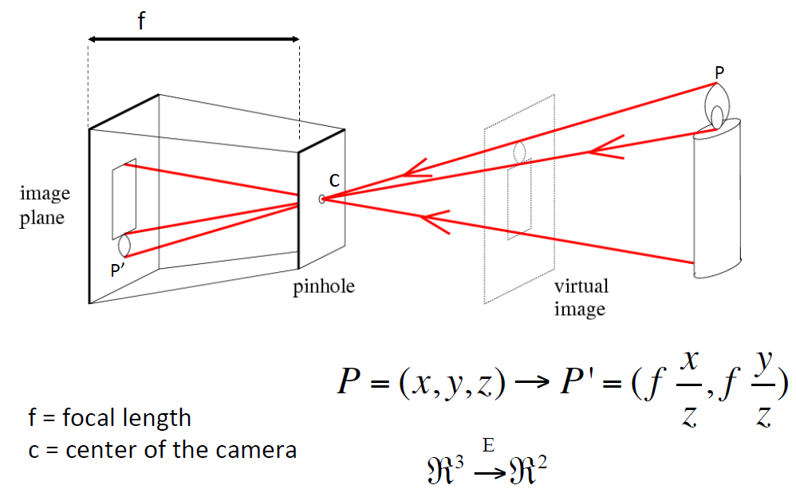
Relating real-world point to a point on a camera

Slide 32
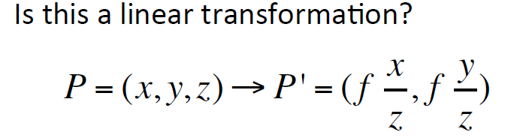
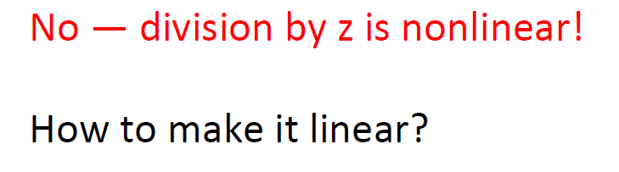
Relating real-world point to a point on a camera

Slide 33
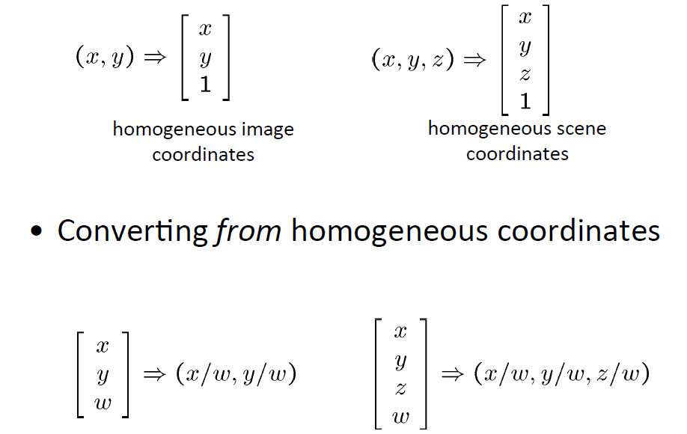
Homogeneous coordinates – a reminder

Slide 34
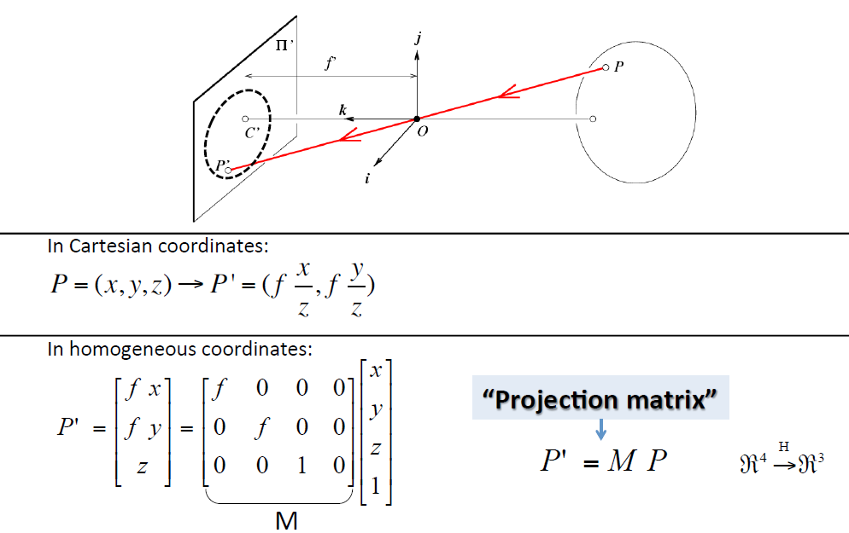
Relating real-world point to a point on a camera

Slide 35
Relating real-world point to a point on a camera
The derived perspective equation (or the projection matrix M) is valid only when all distances are measured in the camera’s reference frame, and when image coordinates have their origin at the image center
In practice, the world and camera coordinate systems are related by a set of physical parameters, such as the focal length of the lens, the size of the pixels, the position of the image center, and the position and orientation of the camera
Two kind of parameters:
Intrinsic parameters which relate the camera’s coordinate system to the idealized coordinate system
Extrinsic parameters which relate the camera’s coordinate system to a fixed world coordinate system and specify its position and orientation in space

Slide 36
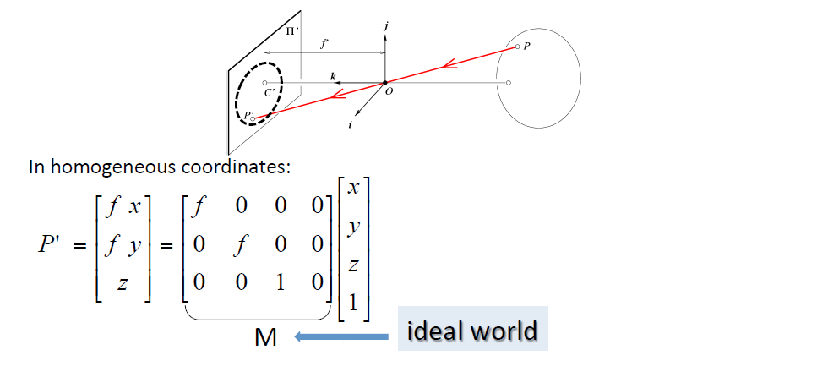
Relating real-world point to a point on a camera
Intrinsic Assumptions
Optical center at (0,0)
Unit aspect ratio
No skew
Extrinsic Assumptions
Camera at (0,0,0)
No rotation

Slide 37
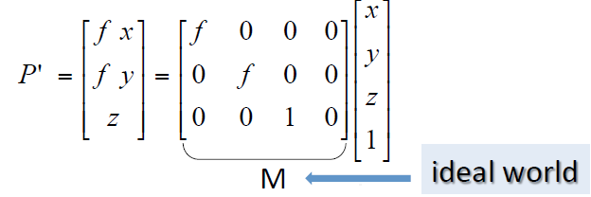
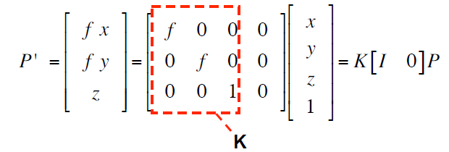
Remove assumption: known optical center
What to do?
or
How to change the matrix M?
Intrinsic Assumptions
Optical center at (u₀,v₀)
Unit aspect ratio
No skew
Extrinsic Assumptions
Camera at (0,0,0)
No rotation

Slide 38
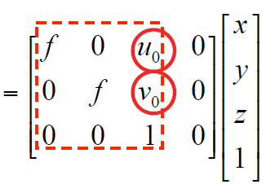
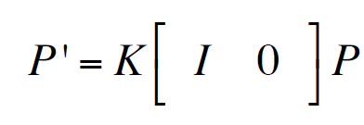
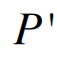
Remove assumption: known optical center
Intrinsic Assumptions
Optical center at (u₀,v₀)
Unit aspect ratio
No skew
Extrinsic Assumptions
Camera at (0,0,0)
No rotation

Slide 39
Remove assumption: square pixels
What to do?
or
How to change the matrix M?
Intrinsic Assumptions
Optical center at (u₀,v₀)
Unit aspect ratio
No skew
Extrinsic Assumptions
Camera at (0,0,0)
No rotation
I.e., instead of square pixels, we allow rectangular pixels

Slide 40
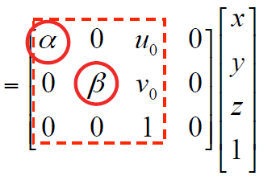
Remove assumption: square pixels
Intrinsic Assumptions
Optical center at (u₀,v₀)
Rectangular pixels
No skew
Extrinsic Assumptions
Camera at (0,0,0)
No rotation

Slide 41
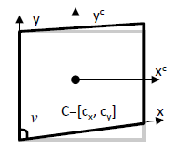
Remove assumption: non-skewed pixels
What to do?
or
How to change the matrix M?
Intrinsic Assumptions
Optical center at (u₀,v₀)
Rectangular pixels
No skew
Extrinsic Assumptions
Camera at (0,0,0)
No rotation
Allow small skew

Slide 42
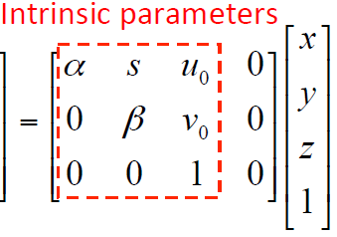
Remove assumption: non-skewed pixels
Intrinsic Assumptions
Optical center at (u₀,v₀)
Rectangular pixels
Allow small skew
Extrinsic Assumptions
Camera at (0,0,0)
No rotation

Slide 43
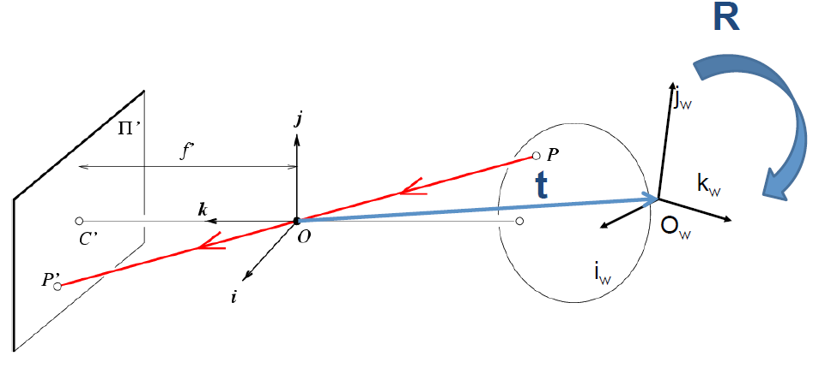
Real world camera: Translate + Rotate
Intrinsic Assumptions
Optical center at (u₀,v₀)
Rectangular pixels
Allow small skew
Extrinsic Assumptions
Camera at (0,0,0)
No rotation

Slide 44
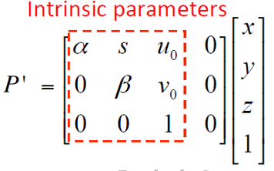
Remove assumption: allow translation
How?
Intrinsic Assumptions
Optical center at (u₀,v₀)
Rectangular pixels
Allow small skew
Extrinsic Assumptions
Camera at (0,0,0) => (t_{x}, t_{y}, t_{z})
No rotation

Slide 45
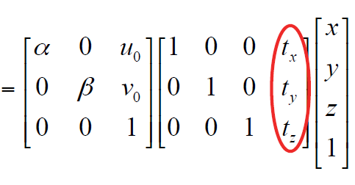
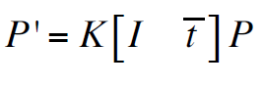
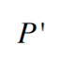
Remove assumption: allow translation
Intrinsic Assumptions
Optical center at (u₀,v₀)
Rectangular pixels
Allow small skew
Extrinsic Assumptions
Camera at (0,0,0) => (t_{x}, t_{y}, t_{z})
No rotation

Slide 46
Remove assumption: allow rotation
Intrinsic Assumptions
Optical center at (u₀,v₀)
Rectangular pixels
Allow small skew
Extrinsic Assumptions
Camera at (0,0,0) => (t_{x}, t_{y}, t_{z})
No rotation => Allow rotation
How?

Slide 47
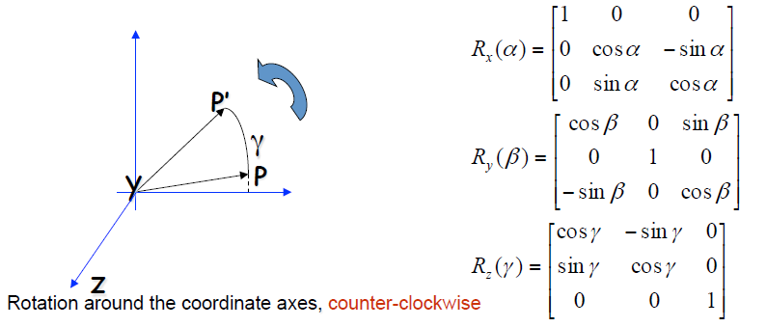
Remove assumption: allow rotation
Intrinsic Assumptions
Optical center at (u₀,v₀)
Rectangular pixels
Allow small skew
Extrinsic Assumptions
Camera at (0,0,0) => (t_{x}, t_{y}, t_{z})
No rotation => Allow rotation

Slide 48


Remove assumption: allow rotation
Intrinsic Assumptions
Optical center at (u₀,v₀)
Rectangular pixels
Allow small skew
Extrinsic Assumptions
Camera at (0,0,0) => (t_{x}, t_{y}, t_{z})
No rotation => Allow rotation

Slide 49

A generic projection matrix
Degrees of freedom??
Intrinsic Assumptions
Optical center at (u₀,v₀)
Rectangular pixels
Allow small skew
Extrinsic Assumptions
Camera at (t_{x}, t_{y}, t_{z})
Allow rotation

Slide 50
A generic projection matrix
Degrees of freedom??
5
6
Intrinsic Assumptions
Optical center at (u₀,v₀)
Rectangular pixels
Allow small skew
Extrinsic Assumptions
Camera at (t_{x}, t_{y}, t_{z})
Allow rotation

Slide 51
A generic projection matrix
Estimating all intrinsic and extrinsic parameters
is referred to as the process of
Geometric Camera Calibration
Intrinsic Assumptions
Optical center at (u₀,v₀)
Rectangular pixels
Allow small skew
Extrinsic Assumptions
Camera at (t_{x}, t_{y}, t_{z})
Allow rotation

Slide 52
Acknowledgements
Various contents in this presentation have been taken from different books, lecture notes, and the web. These solely belong to their owners, and are here used only for clarifying various educational concepts. Any copyright infringement is not intended.

